Slide 1
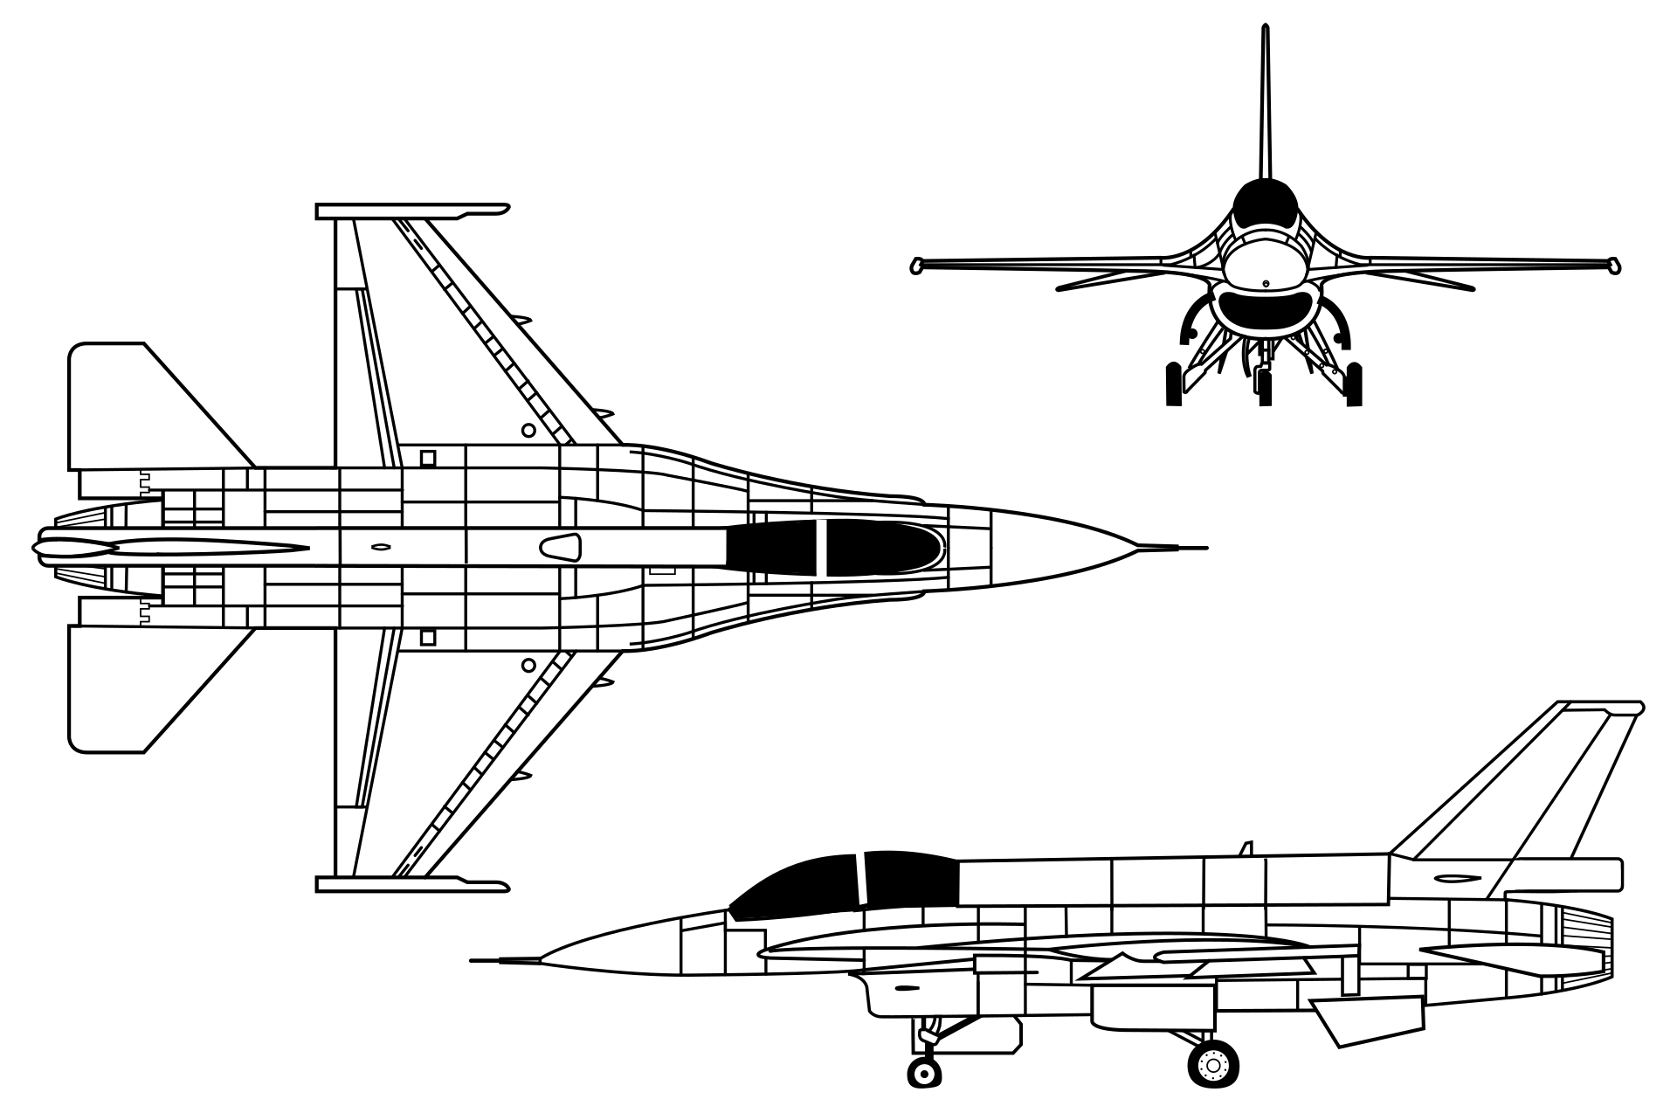
F-16 Optimal Attitude Control
Optimal Control 7210
Brandon Lim

Slide 2
Overview
Introduction
Background
Problem Formulation
Technical Approach
Simulation Results
Future Works
Q&A

Slide 3
Introduction

Slide 4
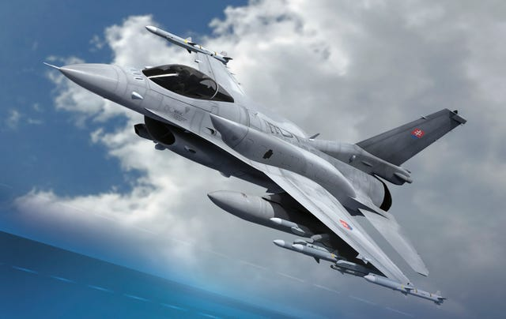
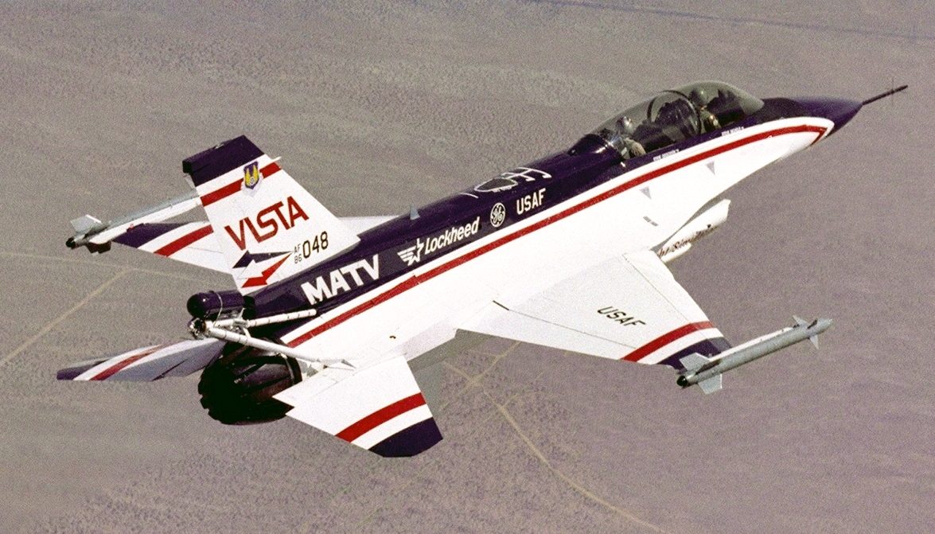
Introduction
While 5th and 6th generation fighters are focused on piloted fleet command, 4th generation fighters like the F-16 become main contenders for autonomous conversion (X-62 VISTA Program)
An autonomous F-16 performs flight maneuvers by altering its attitude to change lift and drag vectors for correct translation
How can we use optimal control to change the attitude of an autonomous F-16?

Slide 5
Background

Slide 6
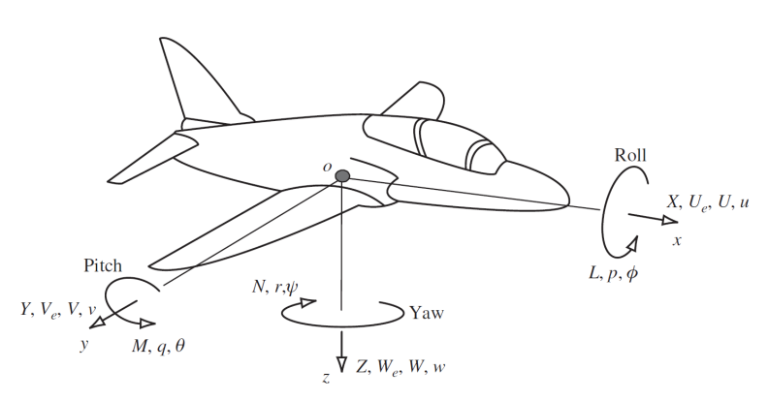
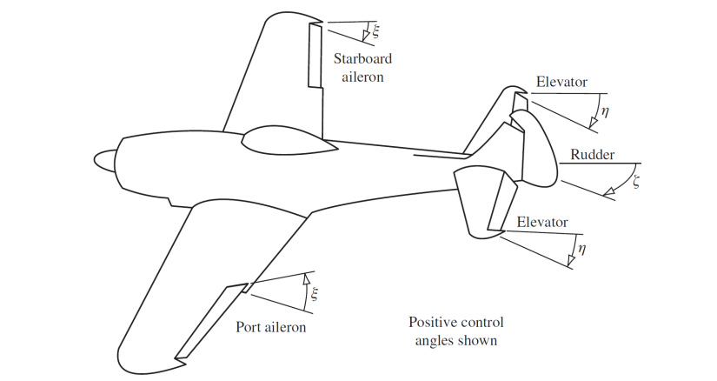
Aircraft Attitude
Aircraft attitude is described by
1 Longitudinal Angle
Pitch Angle – Elevator Controlled
2 Lateral Angles
Roll Angle – Aileron Controlled
Yaw Angle – Rudder Controlled

Slide 7
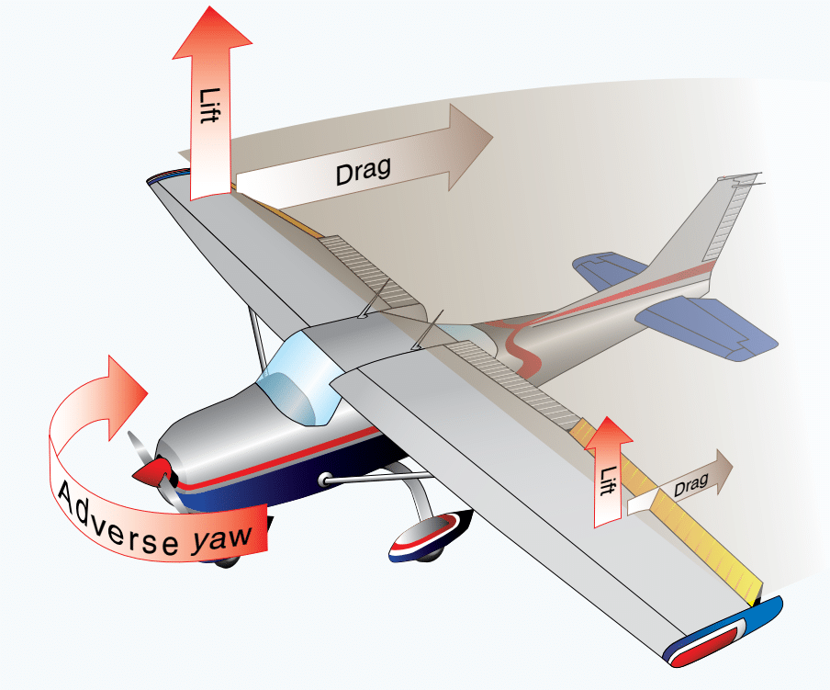
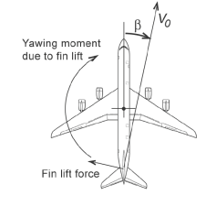
Challenges with Attitude Change
Single attitude changes are difficult or non-feasible to achieve due to dynamic coupling between attitude states
Lateral roll-yaw coupling
Roll maneuvers in aircraft typically have pronounced yaw associated with them due to aerodynamic effects
Adverse Yaw - Differential drag on port and starboard wings causes a yaw moment
Spiral Mode - Sideslip velocity pushes on the vertical tail and creates a yaw moment

Slide 8
Problem Formulation

Slide 9
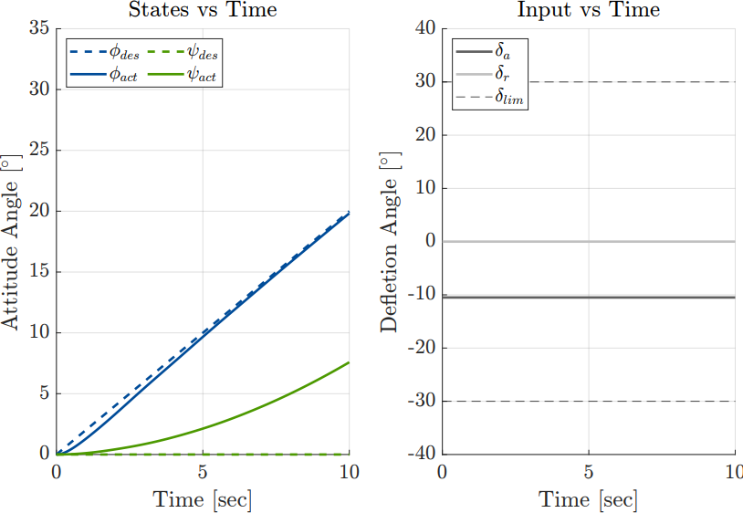
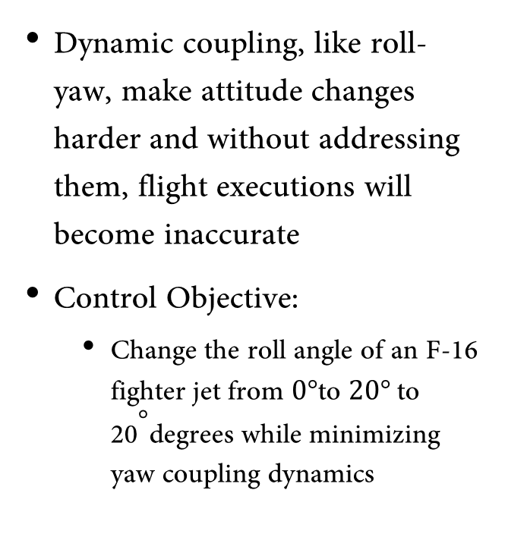
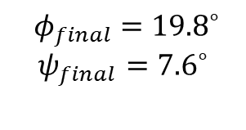
Problem Formulation
Dynamic coupling, like roll-yaw, make attitude changes harder and without addressing them, flight executions will become inaccurate
Control Objective:
Change the roll angle of an F-16 fighter jet from $0°$to $20°$to ${\text{20}}^{°}$degrees while minimizing yaw coupling dynamics
Non-Optimal Baseline Aileron Input Response
$${ φ}_{final} ={19.8}^{∘}$$
$$ψ_{final}={7.6}^{∘}$$

Slide 10
Technical Approach

Slide 11



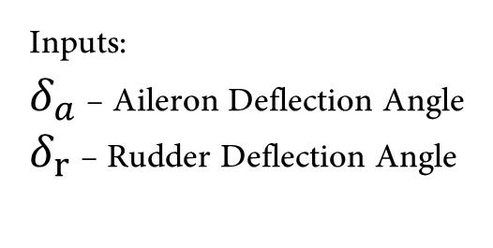
F16 Lateral Model
Linearized for steady, trimmed flight conditions
$$\left[\begin{matrix}\dot{φ} \\ \dot{β} \\ \dot{\begin{aligned}p \\ \dot{r}\end{aligned}}\end{matrix}\right]=\left[\begin{matrix}0 & 0 & 1 & 0.078 \\ 0.064 & −0.202 & 0.078 & −0.99 \\ 0 & −22.92 & −2.25 & 0.54 \\ 0 & 6 & −0.04 & −0.31\end{matrix}\right]\left[\begin{matrix}φ \\ β \\ \begin{aligned}p \\ r\end{aligned}\end{matrix}\right]+\left[\begin{matrix}0 & 0 \\ 0.0002 & 0.0005 \\ −0.4623 & 0.0569 \\ −0.0244 & −0.0469\end{matrix}\right]\left[\begin{matrix}δ_{a} \\ δ_{r}\end{matrix}\right]$$
$$ψ=\int_{t_{0}}^{t_{f}}{rdt}$$
States:
$φ$ – Roll Angle
$β$ – Side Slip Angle
$p$– Roll Rate
$r$ – Yaw Rate
Inputs:
$δ_{a}$ – Aileron Deflection Angle
$δ_{r}$ – Rudder Deflection Angle
Augmented State:
$ψ$ – Yaw Angle

Slide 12
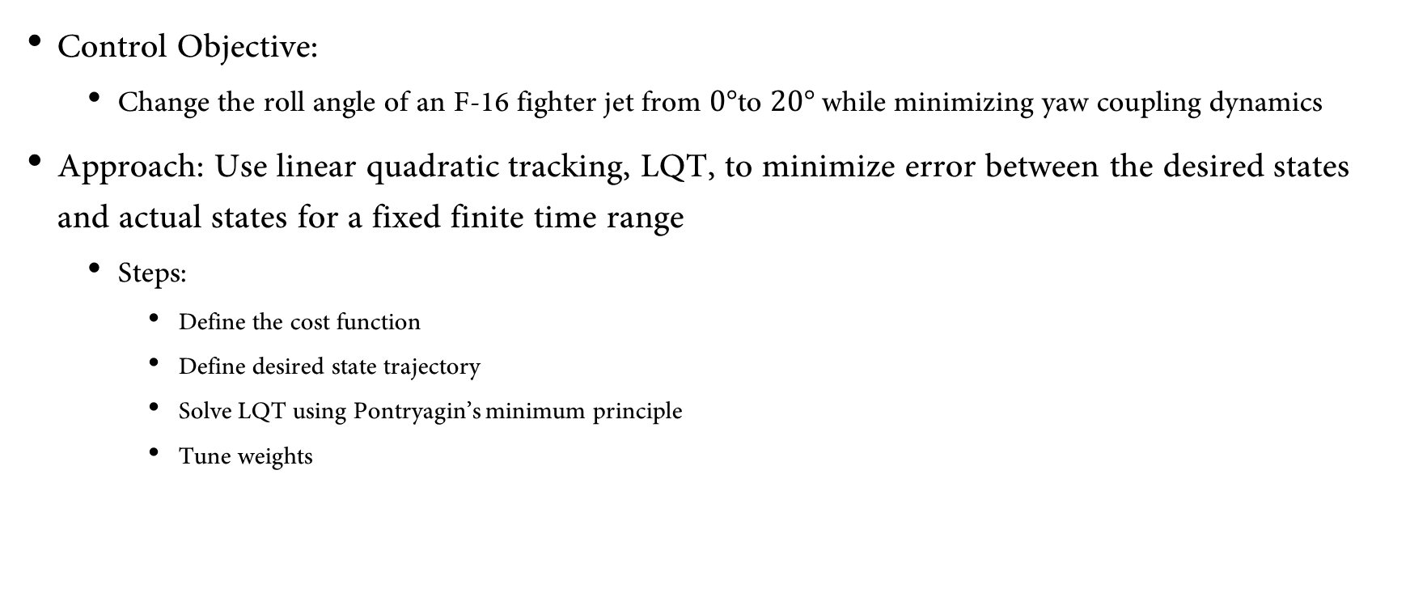
Optimal Approach
Control Objective:
Change the roll angle of an F-16 fighter jet from $0°$to $20°$while minimizing yaw coupling dynamics
Approach: Use linear quadratic tracking, LQT, to minimize error between the desired states and actual states for a fixed finite time range
Steps:
Define the cost function
Define desired state trajectory
Solve LQT using Pontryagin’s minimum principle
Tune weights

Slide 13
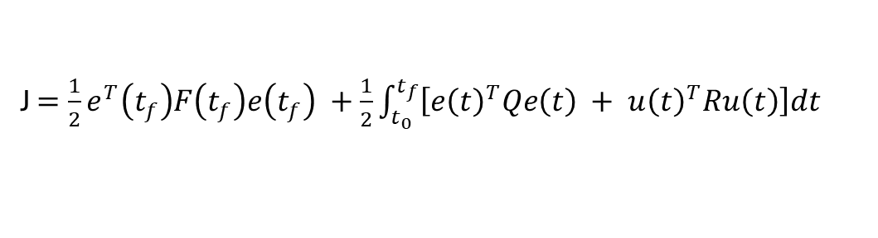
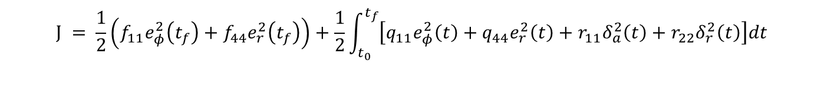




Cost Function
General cost function for LQT
$F$ and $Q$ penalize $φ$ and $r$ while allowing $β$ and $p$ to be free to not over constrain the dynamics
$R$ penalize’s both control inputs to ensure actuator limits aren’t exceeded
Final Cost Function
J $=\frac{1}{2}e^{T}\left(t_{f}\right)F\left(t_{f}\right)e\left(t_{f}\right) +\frac{1}{2}\int_{t_{0}}^{t_{f}}{\left[e{\left(t\right)}^{T}Qe\left(t\right) + u{\left(t\right)}^{T}Ru\left(t\right)\right]dt}$
$$F=\left[\begin{matrix}f_{11} & 0 & 0 & 0 \\ 0 & 0 & 0 & 0 \\ 0 & 0 & 0 & 0 \\ 0 & 0 & 0 & f_{44}\end{matrix}\right]$$
$$Q=\left[\begin{matrix}q_{11} & 0 & 0 & 0 \\ 0 & 0 & 0 & 0 \\ 0 & 0 & 0 & 0 \\ 0 & 0 & 0 & q_{44}\end{matrix}\right]$$
$$R=\left[\begin{matrix}r_{11} & 0 \\ 0 & r_{22}\end{matrix}\right]$$
$$J = \frac{1}{2}\left(f_{11}e_{φ}^{2}\left(t_{f}\right)+f_{44}e_{r}^{2}\left(t_{f}\right)\right)+\frac{1}{2}\int_{t_{0}}^{t_{f}}{\left[q_{11}e_{φ}^{2}\left(t\right)+q_{44}e_{r}^{2}\left(t\right)+r_{11}δ_{a}^{2}\left(t\right)+r_{22}δ_{r}^{2}\left(t\right)\right]dt}$$

Slide 14
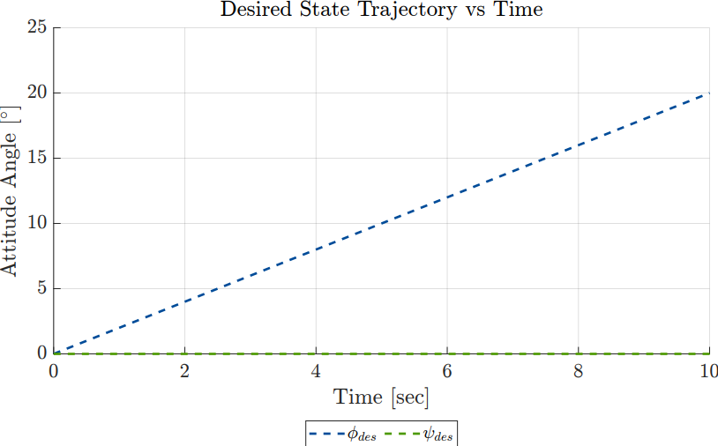
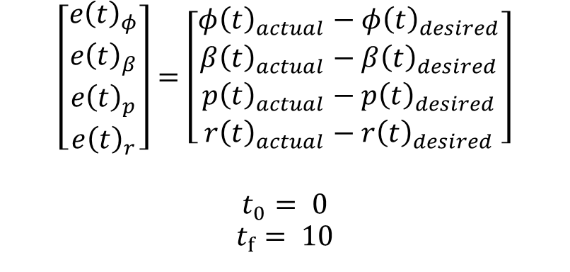
Desired State Trajectory for Tracking
$$\left[\begin{matrix}e{\left(t\right)}_{φ} \\ e{\left(t\right)}_{β} \\ e{\left(t\right)}_{p} \\ e{\left(t\right)}_{r}\end{matrix}\right]=\left[\begin{matrix}φ{\left(t\right)}_{actual}−φ{\left(t\right)}_{desired} \\ β{\left(t\right)}_{actual}−β{\left(t\right)}_{desired} \\ p{\left(t\right)}_{actual}−p{\left(t\right)}_{desired} \\ r{\left(t\right)}_{actual}−r{\left(t\right)}_{desired}\end{matrix}\right]$$
$$t_{0}= 0$$
$$t_{f}= 10$$

Slide 15
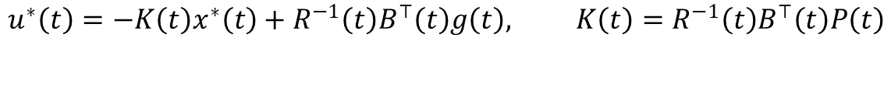
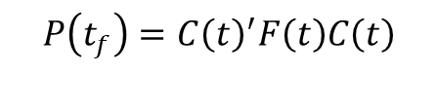
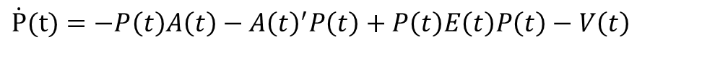


Solving LQT
- Solve matrix differential Ricatti equation backwards in time
with BC
- Solve vector differential equation backwards in time
with BC
- Solve optimal state progression forwards in time
with BC for initial trimmed flight
- Solve for optimal input
$\dot{P}(t)=−P\left(t\right)A\left(t\right)−{A\left(t\right)}^{′}P\left(t\right)+P\left(t\right)E\left(t\right)P\left(t\right)−V\left(t\right)$
$$P\left(t_{f}\right)=C{\left(t\right)}^{′}F\left(t\right)C\left(t\right)$$
$$\dot{g}\left(t\right)=\left[P\left(t\right)E\left(t\right)−{A\left(t\right)}^{′}\right]g\left(t\right)−W\left(t\right)z\left(t\right)$$
$$g\left(t_{f}\right)={C(t)}^{′}F(t)z\left(t_{f}\right)$$
$$\dot{x}*\left(t\right)=\left[A\left(t\right)−E\left(t\right)P\left(t\right)\right]x^{∗}\left(t\right)+E\left(t\right)g\left(t\right)$$
$$x(t=0) = [\begin{matrix}0 & 0 \end{matrix}\begin{matrix}0 & 0\end{matrix}]′$$
$$u^{∗}\left(t\right)=−K\left(t\right)x^{∗}\left(t\right)+R^{−1}\left(t\right)B^{⊤}\left(t\right)g\left(t\right), K\left(t\right)=R^{−1}\left(t\right)B^{⊤}\left(t\right)P\left(t\right)$$

Slide 16
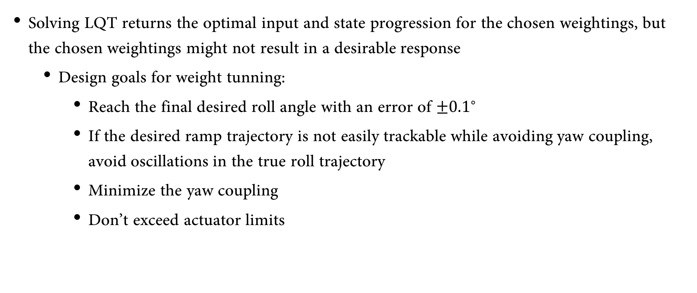
Design Goals for Weight Tuning
Solving LQT returns the optimal input and state progression for the chosen weightings, but the chosen weightings might not result in a desirable response
Design goals for weight tunning:
Reach the final desired roll angle with an error of $±{0.1}^{∘}$
If the desired ramp trajectory is not easily trackable while avoiding yaw coupling, avoid oscillations in the true roll trajectory
Minimize the yaw coupling
Don’t exceed actuator limits

Slide 17
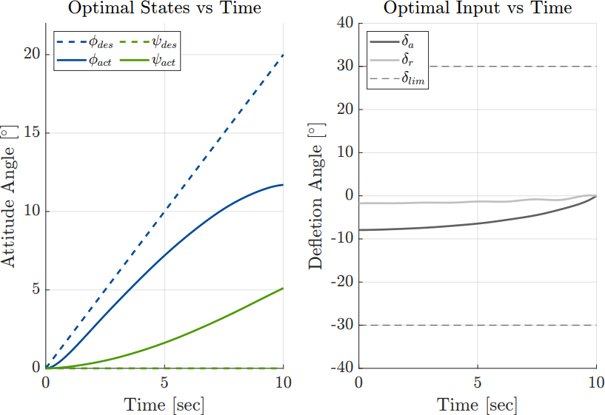
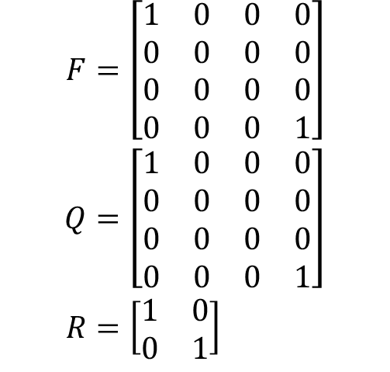
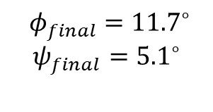
Weightings Case 1
$$\begin{aligned}F&=\left[\begin{matrix}1 & 0 & 0 & 0 \\ 0 & 0 & 0 & 0 \\ 0 & 0 & 0 & 0 \\ 0 & 0 & 0 & 1\end{matrix}\right] \\ Q&=\left[\begin{matrix}1 & 0 & 0 & 0 \\ 0 & 0 & 0 & 0 \\ 0 & 0 & 0 & 0 \\ 0 & 0 & 0 & 1\end{matrix}\right] \\ R&=\left[\begin{matrix}1 & 0 \\ 0 & 1\end{matrix}\right]\end{aligned}$$
$${ φ}_{final} ={11.7}^{∘}$$
$$ψ_{final}={5.1}^{∘}$$

Slide 18
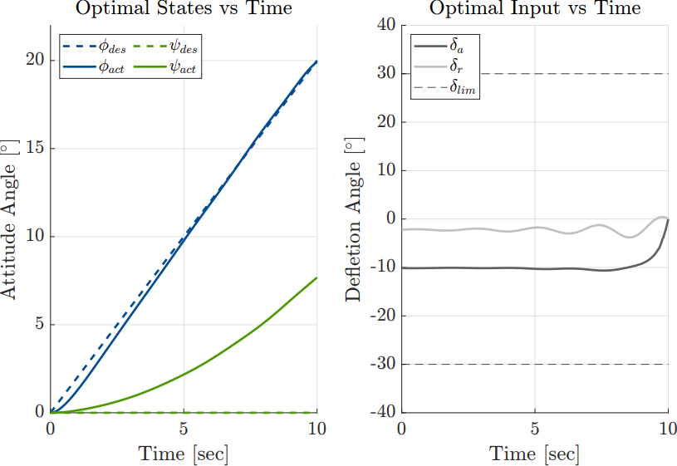
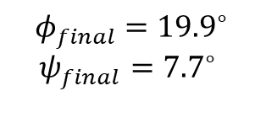
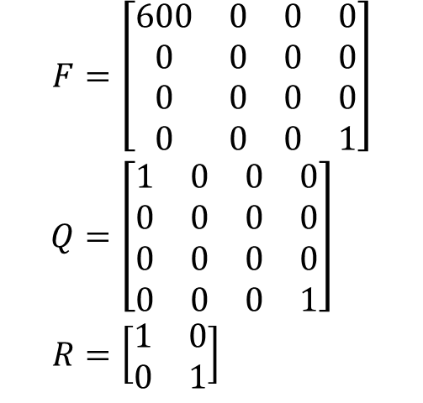
Weightings Case 2
$$\begin{aligned}F&=\left[\begin{matrix}600 & 0 & 0 & 0 \\ 0 & 0 & 0 & 0 \\ 0 & 0 & 0 & 0 \\ 0 & 0 & 0 & 1\end{matrix}\right] \\ Q&=\left[\begin{matrix}1 & 0 & 0 & 0 \\ 0 & 0 & 0 & 0 \\ 0 & 0 & 0 & 0 \\ 0 & 0 & 0 & 1\end{matrix}\right] \\ R&=\left[\begin{matrix}1 & 0 \\ 0 & 1\end{matrix}\right]\end{aligned}$$
$${ φ}_{final} ={19.9}^{∘}$$
$$ψ_{final}={7.7}^{∘}$$

Slide 19
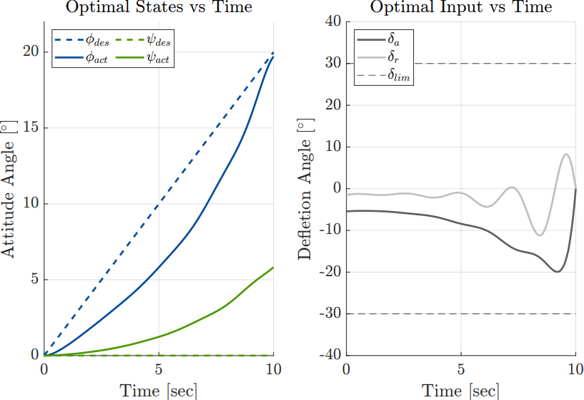
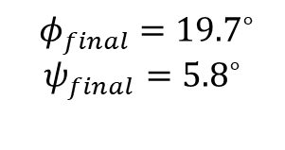
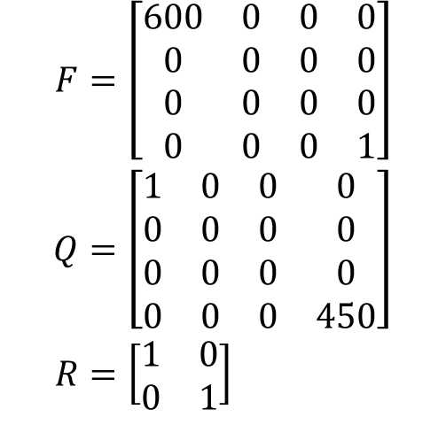
Weightings Case 3
$$\begin{aligned}F&=\left[\begin{matrix}600 & 0 & 0 & 0 \\ 0 & 0 & 0 & 0 \\ 0 & 0 & 0 & 0 \\ 0 & 0 & 0 & 1\end{matrix}\right] \\ Q&=\left[\begin{matrix}1 & 0 & 0 & 0 \\ 0 & 0 & 0 & 0 \\ 0 & 0 & 0 & 0 \\ 0 & 0 & 0 & 450\end{matrix}\right] \\ R&=\left[\begin{matrix}1 & 0 \\ 0 & 1\end{matrix}\right]\end{aligned}$$
$${ φ}_{final} ={19.7}^{∘}$$
$$ψ_{final}={5.8}^{∘}$$

Slide 20
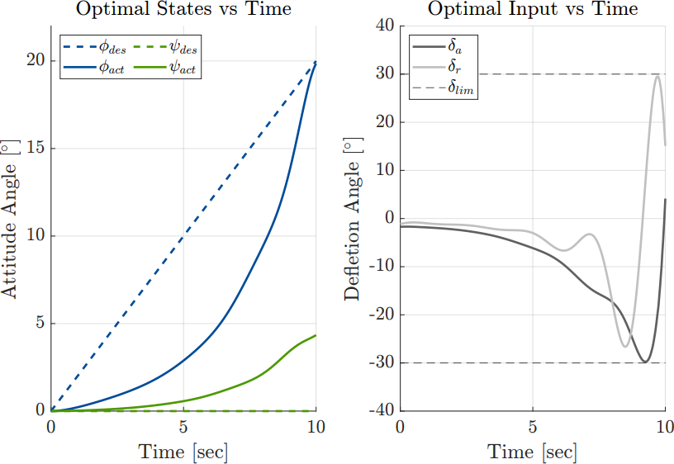
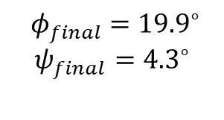
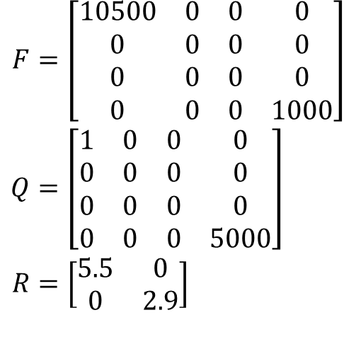
Weightings Case 4
$$\begin{aligned}F&=\left[\begin{matrix}10500 & 0 & 0 & 0 \\ 0 & 0 & 0 & 0 \\ 0 & 0 & 0 & 0 \\ 0 & 0 & 0 & 1000\end{matrix}\right] \\ Q&=\left[\begin{matrix}1 & 0 & 0 & 0 \\ 0 & 0 & 0 & 0 \\ 0 & 0 & 0 & 0 \\ 0 & 0 & 0 & 5000\end{matrix}\right] \\ R&=\left[\begin{matrix}5.5 & 0 \\ 0 & 2.9\end{matrix}\right]\end{aligned}$$
$${ φ}_{final} ={19.9}^{∘}$$
$$ψ_{final}={4.3}^{∘}$$

Slide 21
Simulation Results

Slide 22
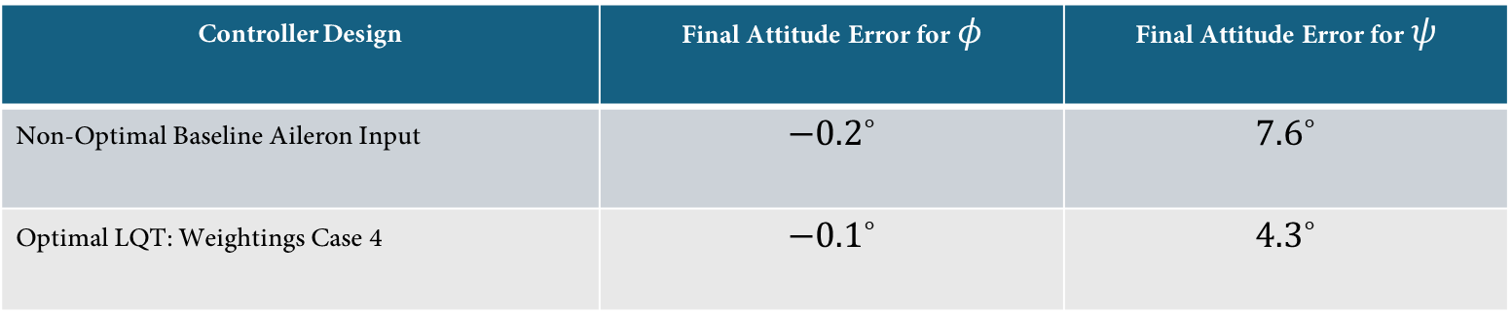
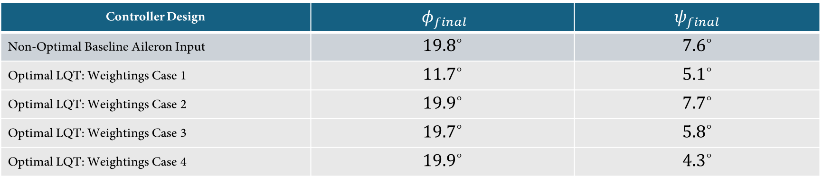
Final Attitude Comparison Summary
Controller Design | $${ φ}_{final}$$ | $$ψ_{final}$$
Non-Optimal Baseline Aileron Input | $${19.8}^{∘}$$ | $${7.6}^{∘}$$
Optimal LQT: Weightings Case 1 | $${11.7}^{∘}$$ | $${5.1}^{∘}$$
Optimal LQT: Weightings Case 2 | $${19.9}^{∘}$$ | $${7.7}^{∘}$$
Optimal LQT: Weightings Case 3 | $${19.7}^{∘}$$ | $${5.8}^{∘}$$
Optimal LQT: Weightings Case 4 | $${19.9}^{∘}$$ | $${4.3}^{∘}$$
Non-Optimal vs Optimal Comparison
Controller Design | Final Attitude Error for $φ$ | Final Attitude Error for $ψ$
Non-Optimal Baseline Aileron Input | $${−0.2}^{∘}$$ | $${7.6}^{∘}$$
Optimal LQT: Weightings Case 4 | $${−0.1}^{∘}$$ | $${4.3}^{∘}$$

Slide 23
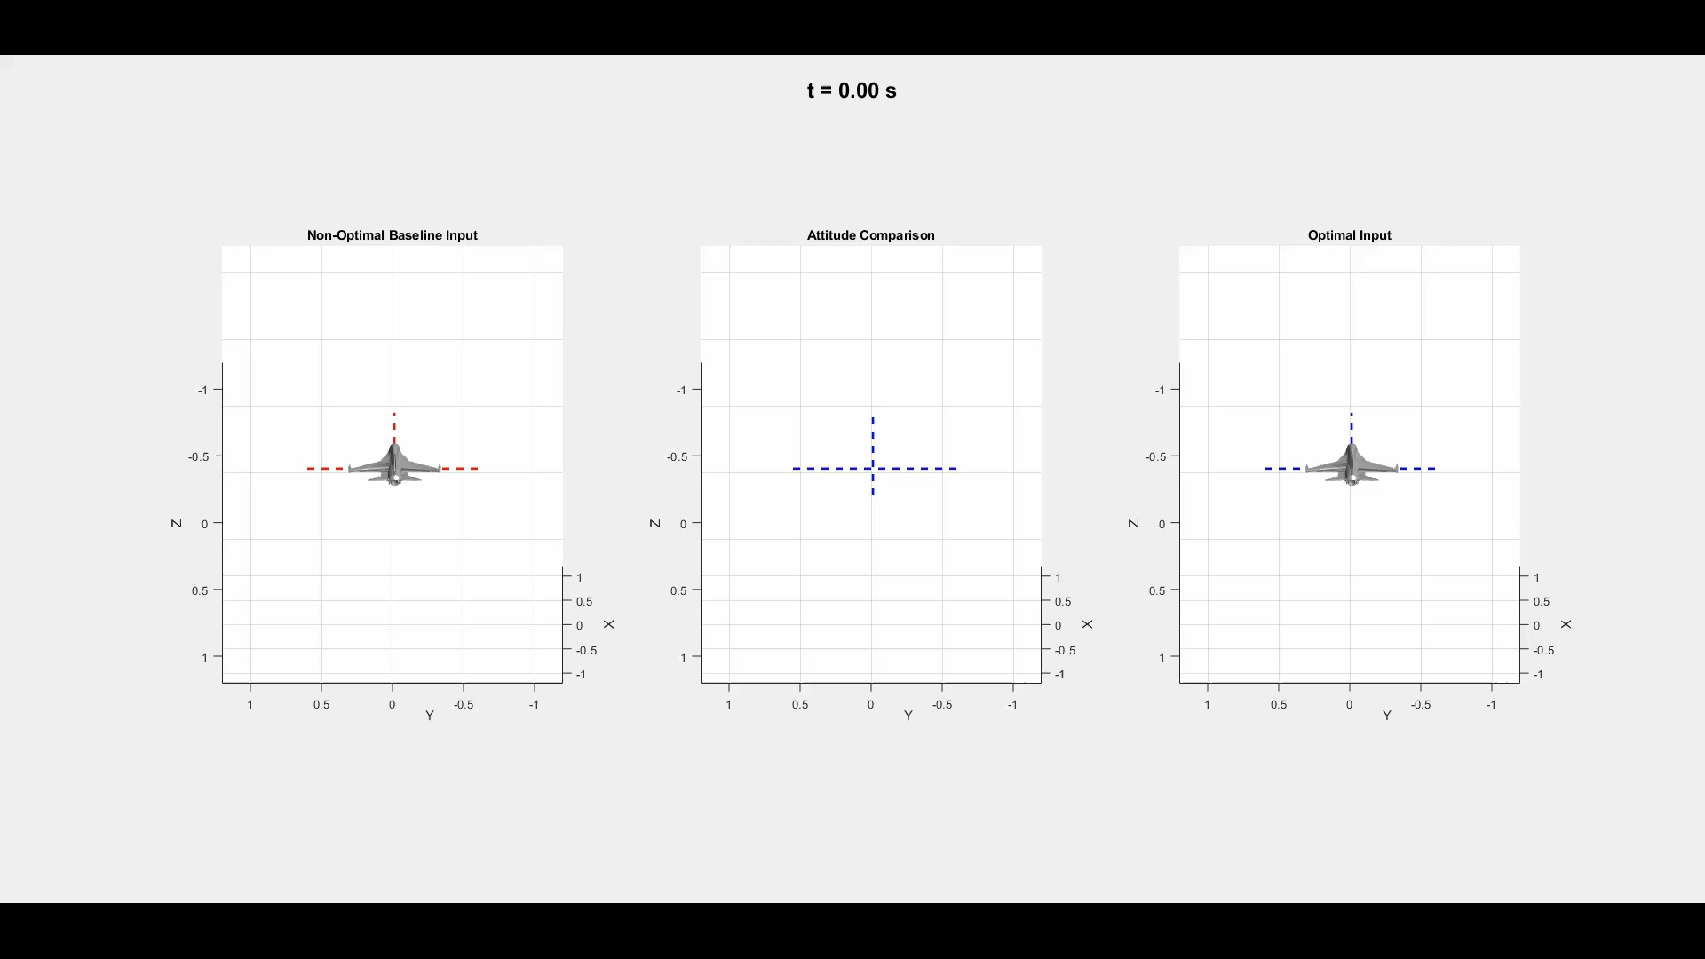

Slide 24
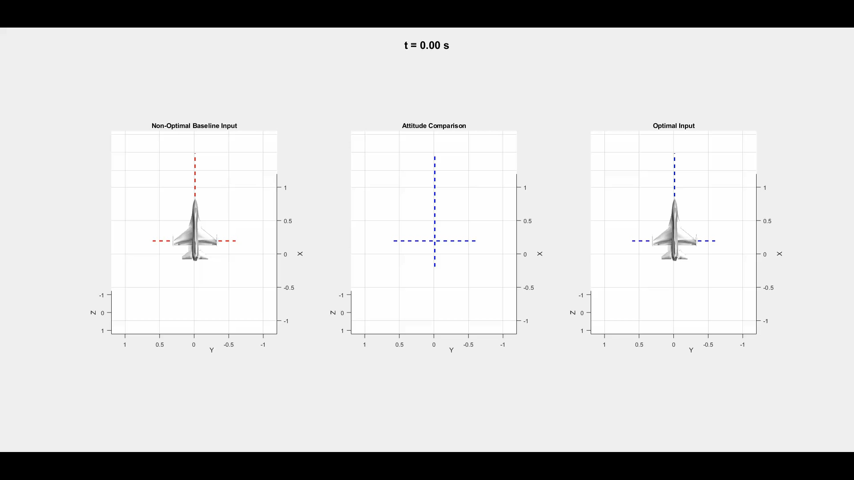

Slide 25
Future Work
Use a dynamic model that has the yaw angle as a direct state for minimization
Yaw rate is the state most indicative of the yaw angle, but the other states do play some sort of roll in those dynamics. To better suppress yaw coupling, a direct yaw state will have greater impact on optimization
Use a dynamic model that has individual aileron input’s rather than a single antisymmetric aileron input

Slide 26
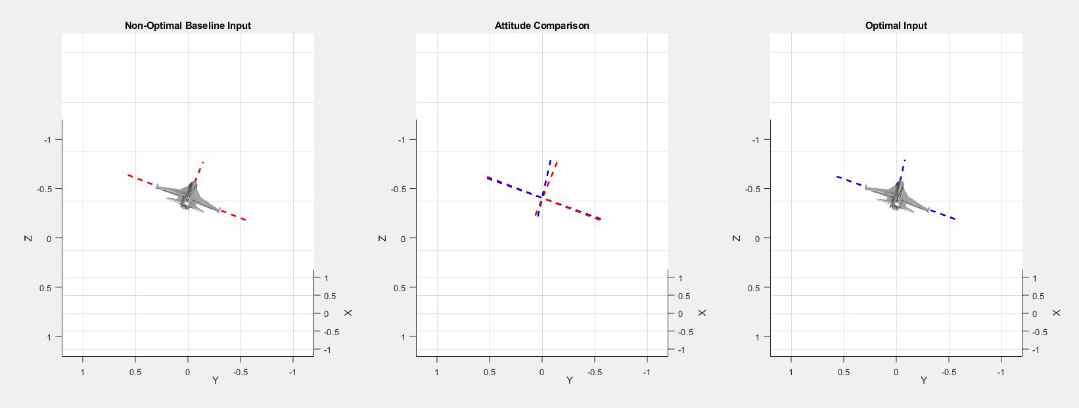
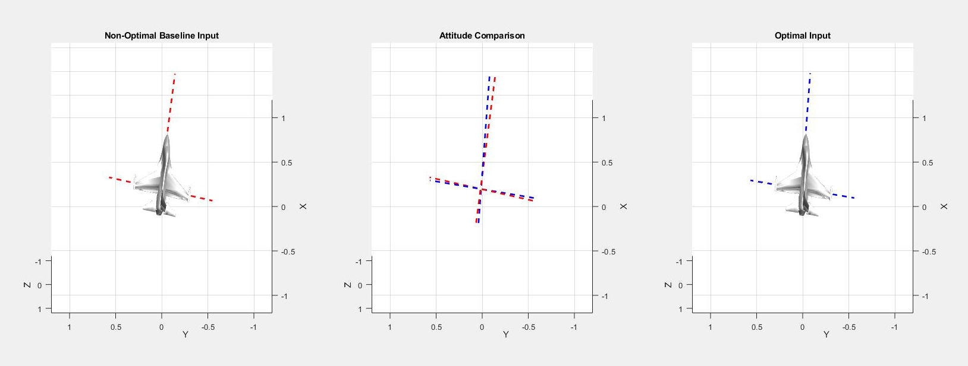
Questions?

Slide 27
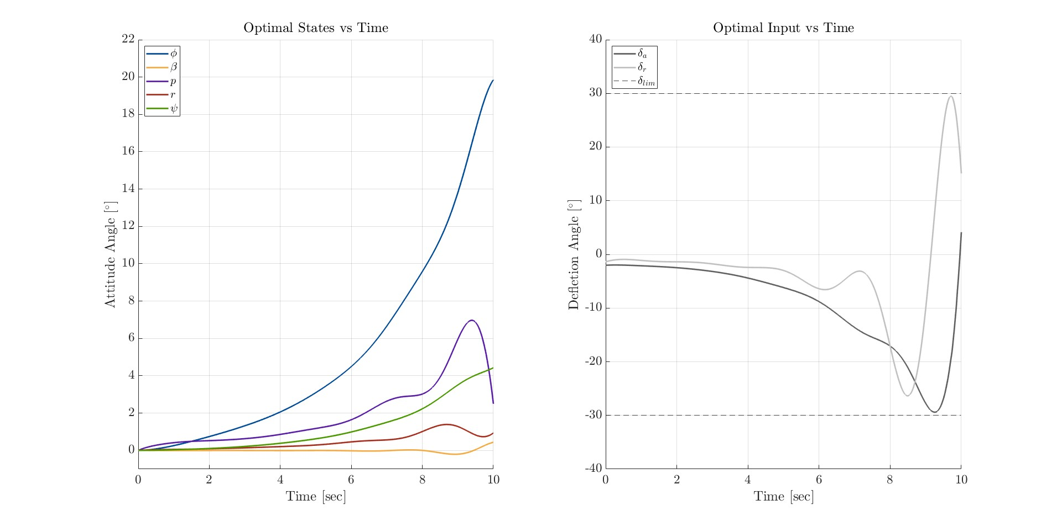
Appendix 1: Full State Progression

